Slide 1



Open Minds Club
AI School Iteration 2.4
Classification Metrics
By BOULGHERAIF Fatma Zohra
<h4>
</h4>

Slide 2

Open Minds Club
Quick Recap

Slide 3
Open Minds Club
01. What Classification Outputs
👉 Two kinds of output depending on the model:
Output type | Example | Used for
Probability | P(y=1 | x) = 0.73 | Logistic regression
Label | ŷ = 1 | Decision trees, kNN
When you have probabilities, a threshold converts them to a label:
ŷ = 1 if P(y=1 | x) ≥ threshold
ŷ = 0 otherwise

Slide 4
Open Minds Club
Metrics

Slide 5
Open Minds Club
02. Accuracy
Proportion of correctly classified samples over the total number of samples.
Accuracy = # Correct predictions / # Total predictions
Limitation — class imbalance:
Consider a dataset where 99% of samples belong to class 0. A classifier that always predicts class 0 achieves 99% accuracy while never detecting class 1
Accuracy is an insufficient metric when:
- Class distributions are imbalanced
- The cost of false positives and false negatives differs

Slide 6
Open Minds Club
03. Confusion Matrix
For binary classification, every prediction falls into one of four categories: FP, TP, FN, TN
Definitions:
- TP: positive sample correctly classified as positive
- TN: negative sample correctly classified as negative
- FP: negative sample incorrectly classified as positive
- FN: positive sample incorrectly classified as negative
F => incorrectly classified as P or N
T => correctly classified as P or N

Slide 7
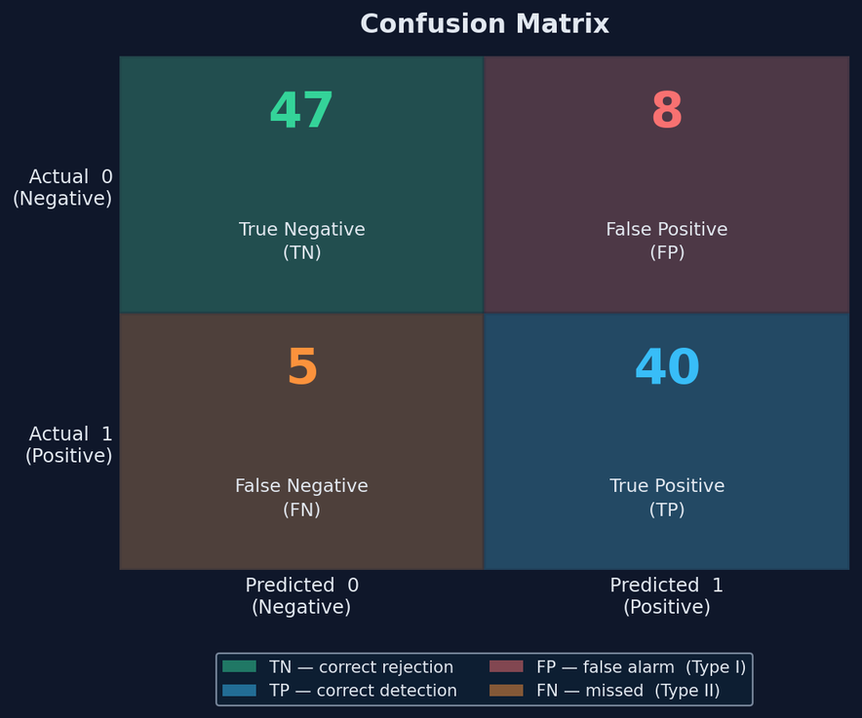
Open Minds Club
03. Confusion Matrix
The relative cost of FP vs. FN is problem-dependent and should be defined before model selection.
Examples:
- Medical diagnosis: FN (missed disease) is typically more costly than FP
- Spam filtering: FP (legitimate email classified as spam) may be more costly than FN

Slide 8
Open Minds Club
02. Accuracy
Accuracy = (TP + TN) / (TP + TN + FP + FN)

Slide 9
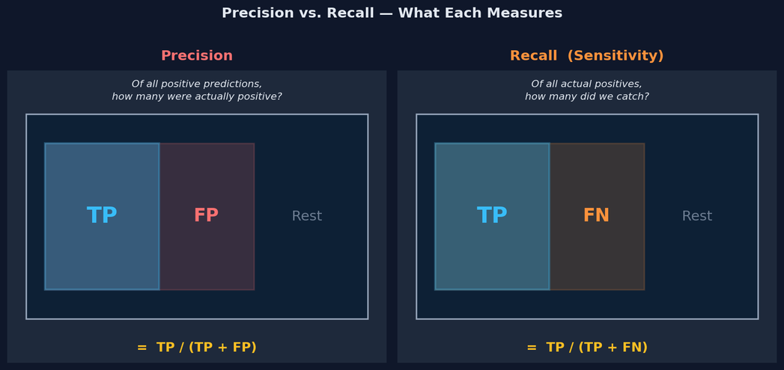
Open Minds Club
04. Precision & Recall
  Precision: Proportion of positive predictions that are correct. Quantifies the false alarm rate.
Precision (P) = TP / (TP + FP)
AKA TP / Prediction = 1
  Recall (True Positive Rate / Sensitivity): Proportion of actual positives that were correctly detected. Quantifies the missed detection rate.
Recall (R) = TP / (TP + FN)
AKA TP / Real = 1

Slide 10
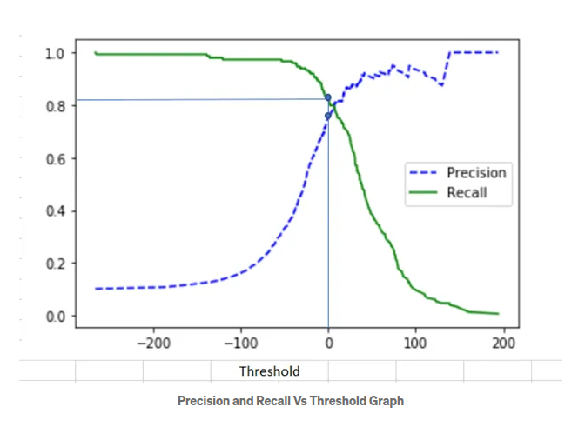
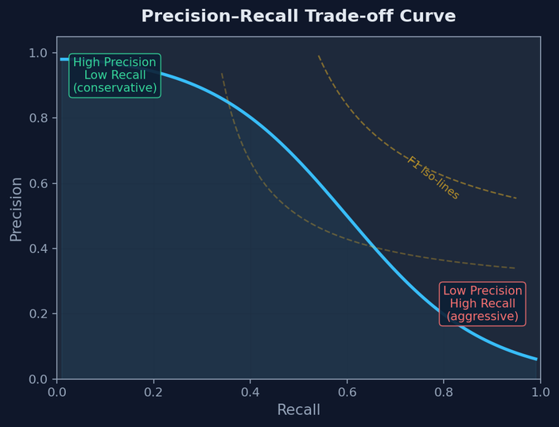
Open Minds Club
04. Precision & Recall
The trade-off in the case of probability based classification:
Pushing the threshold down (more aggressive):
- ↑ Recall — you catch more positives
- ↓ Precision — but you also flag more negatives wrongly
Pushing the threshold up (more conservative):
- ↑ Precision — everything you flag is likely real
- ↓ Recall — but you miss more actual positives

Slide 11
Open Minds Club
05. F1 Score
F1 is the harmonic mean of precision and recall:
F1 = 2 · (Precision · Recall) / (Precision + Recall)
The harmonic mean is used rather than the arithmetic mean because it returns 0 when either component is 0. A degenerate classifier predicting all samples as positive achieves Recall = 1 but Precision ≈ 0, yielding F1 ≈ 0.

Slide 12
Open Minds Club
05. Fβ Score
F-beta score: generalisation allowing asymmetric weighting:
Fβ = (1 + β²) · (Precision · Recall) / (β² · Precision + Recall)
beta | weighting
β < 1 | Precision-weighted: penalises FP more heavily
β = 1 | Standard F1: equal weighting
β > 1 | Recall-weighted: penalises FN more heavily

Slide 13
Open Minds Club
Practice Time
  Accuracy?
  Precision?
  Recall?
  F1 Score

Slide 14
Open Minds Club
Visual Evaluation

Slide 15
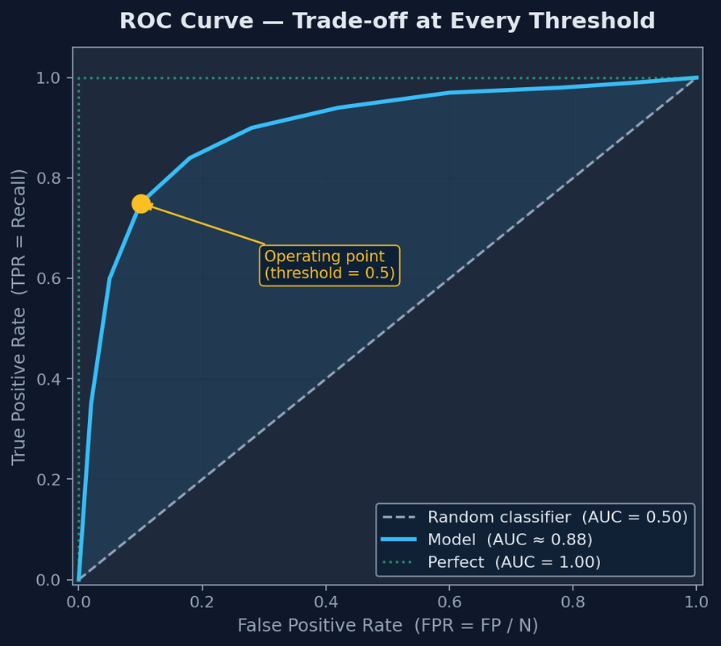
Open Minds Club
06. ROC Curve & AUC (1/2)
Rather than evaluating at a single threshold, the ROC curve characterises classifier performance across all thresholds τ ∈ [0, 1].
+ Threshold-independent: evaluates the model's ability to rank positive samples above negative ones
x-axis: FPR = FP / (FP + TN)
y-axis: TPR = TP / (TP + FN)

Slide 16
Open Minds Club
06. ROC Curve & AUC (2/2)
AUC (Area Under the ROC Curve)
AUC | Interpretation
1.0 | Perfect classifier
0.5 | Random classifier, no discriminative power
<0.5 | Worse than random

Slide 17
Open Minds Club
Multiclass classification

Slide 18
Open Minds Club
  Multiclass Classification
Definition: Classification where y ∈ {1, 2, ..., K} for K > 2.
Examples:
- Iris species → {Setosa, Versicolor, Virginica}
- Image recognition → {Cat, Dog, Bird, Fish, Horse, ...}
- Clinical staging → {Benign, Stage I, Stage II, Stage III}
Main approaches:
  Native multiclass: Model outputs K probabilities simultaneously — Softmax
  Some models (like logistic regression or SVMs) handle multiclass by combining multiple binary classifiers (OvR / OvO).
  Many modern models support multiclass directly.

Slide 19

Open Minds Club
  Softmax for Multiclass Output (1/3)
For K classes, the model computes K independent linear scores (logits), one for each class:
zₖ = β₀ₖ + β₁ₖx₁ + ... + βₙₖxₙ for k = 1, ..., K
The Softmax function normalises the logit vector into a valid probability distribution:
P(y = k | x) = exp(zₖ) / Σⱼ exp(zⱼ)
- P(y = k | x) ∈ (0, 1) for all k
- Σₖ P(y = k | x) = 1

Slide 20
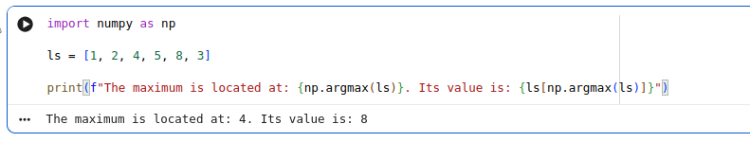
Open Minds Club
  Softmax for Multiclass Output (2/3)
Prediction:
ŷ = argmax_k P(y = k | x)
The sigmoid function is a special case of Softmax with K = 2.

Slide 21
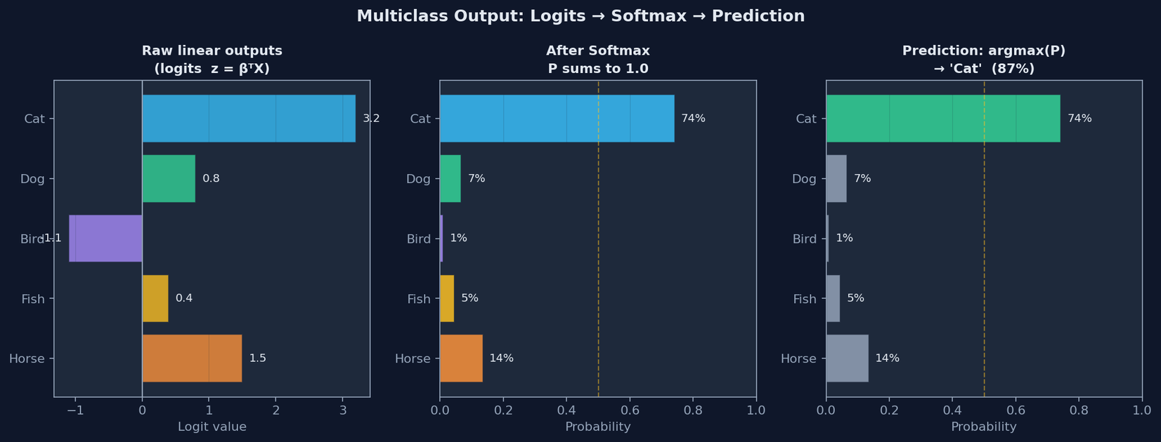
Open Minds Club
  Softmax for Multiclass Output (3/3)

Slide 22
Open Minds Club
Multiclass evaluation

Slide 23
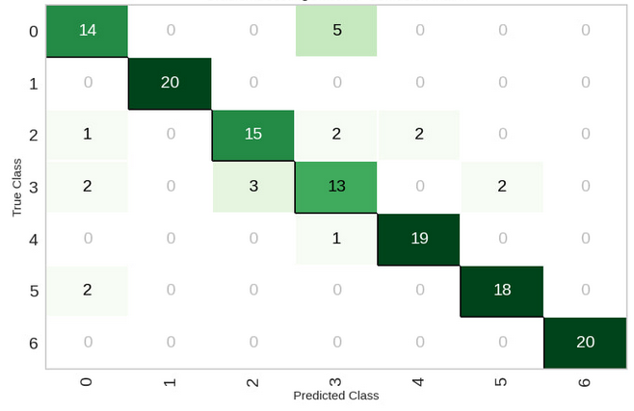
Open Minds Club
  Multiclass Evaluation (1/2)
K×K Confusion matrix:
- Diagonal entries: correct predictions per class
- Off-diagonal entries: class confusions (e.g. class i predicted as class j)

Slide 24
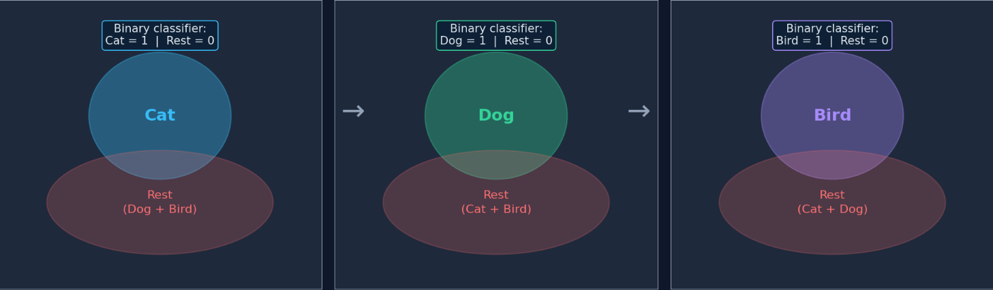
Open Minds Club
  Multiclass Evaluation (2/2)
Per-class precision, recall, and F1 are computed by treating each class as the positive class under an OvR framing.

Slide 25
Open Minds Club
Example
  Averaging Strategies (1/2)
Macro Precision = (1/K) · Σₖ Precisionₖ
Each class contributes equally regardless of sample count. Appropriate when performance on minority classes is as important as on majority classes.
Weighted Precision = Σₖ (supportₖ · Precisionₖ) / N
Each class is weighted by its sample count. Reflects overall performance on the observed distribution. Can mask poor performance on minority classes.
Micro Precision = Σₖ TPₖ / (Σₖ TPₖ + Σₖ FPₖ)
Pools TP/FP/FN counts across all classes before computing the metric.

Slide 26
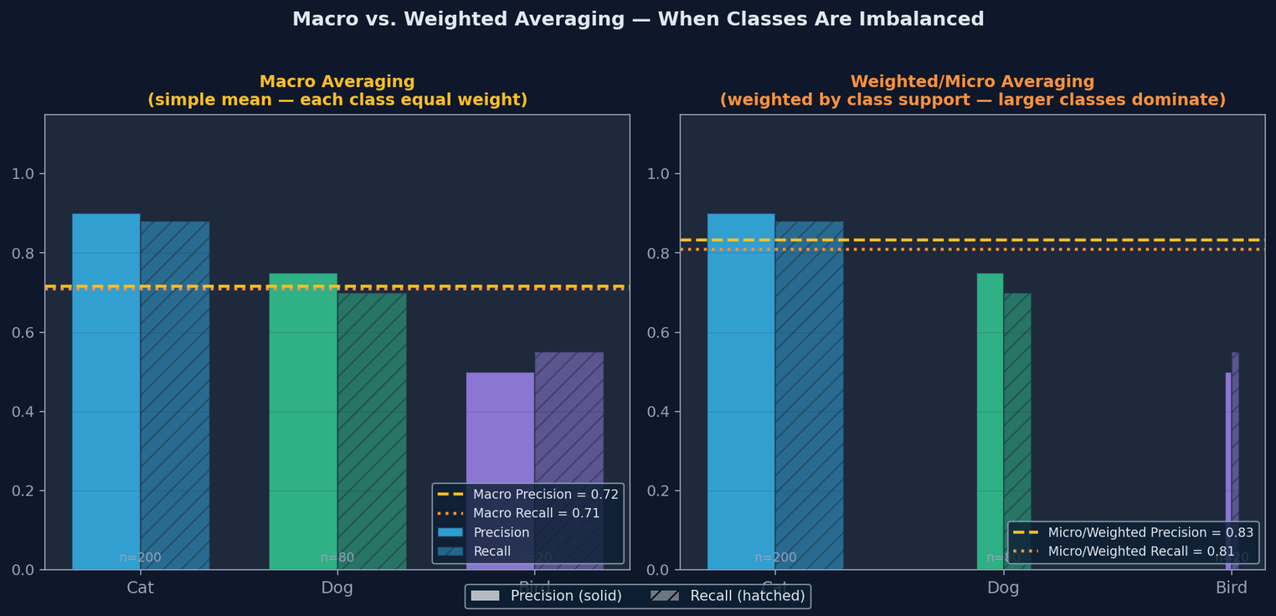
Open Minds Club
  Averaging Strategies (2/2)

Slide 27
Open Minds Club
In Practice

Slide 28
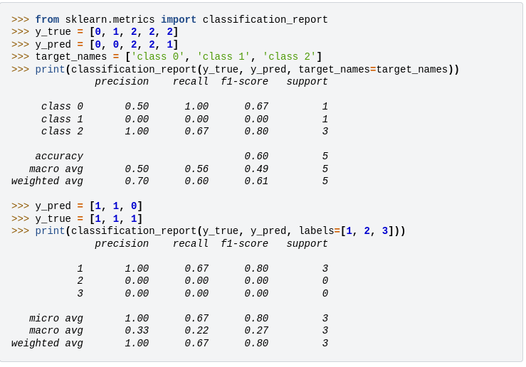
Open Minds Club
  sklearn for evaluation

Slide 29
Open Minds Club
Metric Selection

Slide 30
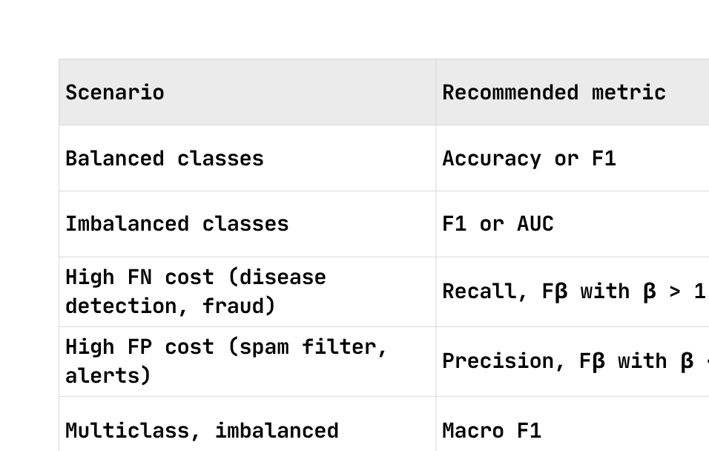
Open Minds Club
  Metric Selection

Slide 31

Open Minds Club
Any Questions ?

Slide 32
Open Minds Club
Thank you for your attention ✨

